Slide 1

Burgers’ Equation
Numerical Simulations using Finite Difference Scheme
Bharat Varshney 150183 Yaman Sanghavi 150831

Slide 2

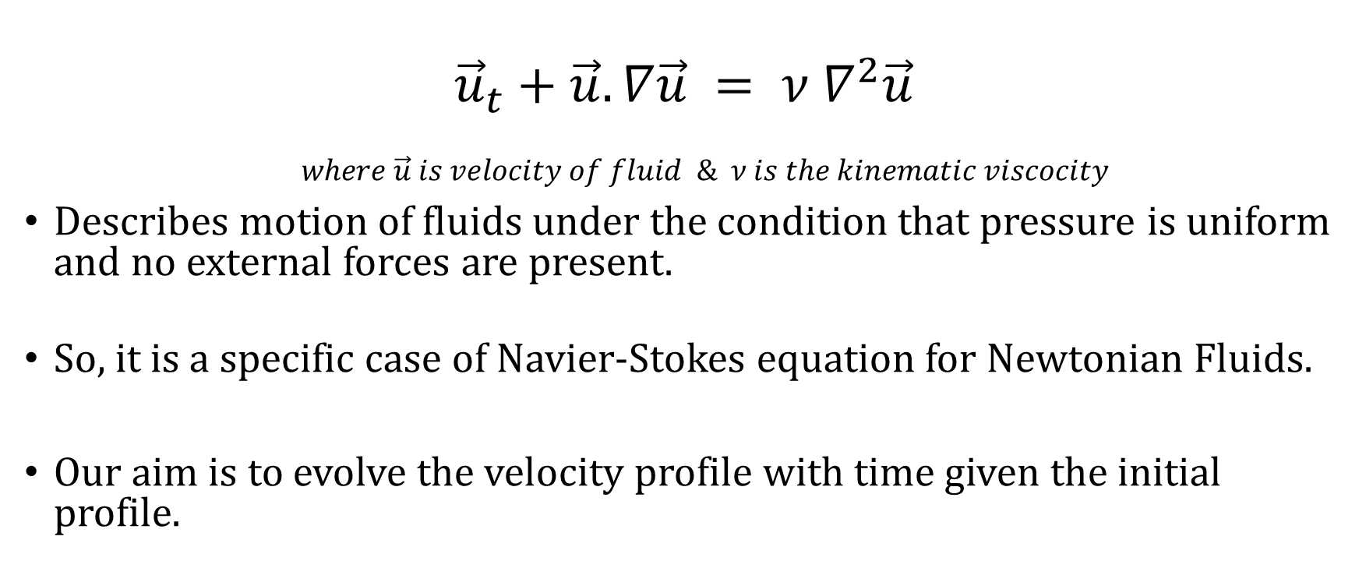
What is Burgers’ Equation?
$${\vec{u}}_{t}+\vec{u}.∇\vec{u} = ν ∇^{2}\vec{u}$$
$$where \vec{u} is velocity of fluid \& ν is the kinematic viscocity$$
Describes motion of fluids under the condition that pressure is uniform and no external forces are present.
So, it is a specific case of Navier-Stokes equation for Newtonian Fluids.
Our aim is to evolve the velocity profile with time given the initial profile.

Slide 3
What is Burgers’ Equation?
Fundamental PDE that occurs in various fields:
Turbulence
Traffic Flow
Non-linear acoustics
Named after the scientist J. M. Burgers.

Slide 4
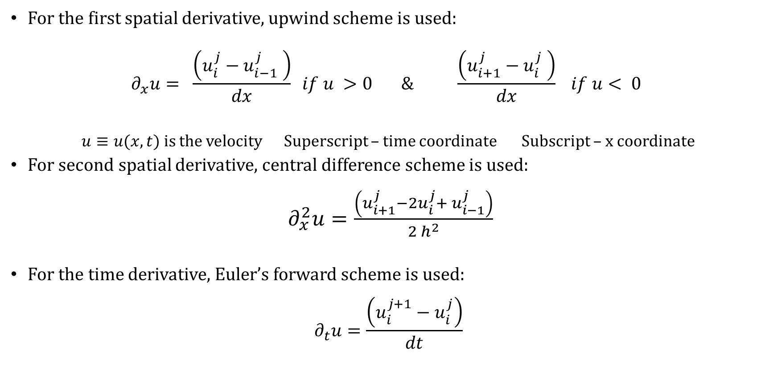
Numerical Method:
For the first spatial derivative, upwind scheme is used:
$$∂_{x}u= \frac{\left(u_{i}^{j}−u_{i−1}^{j} \right)}{dx} if u >0 \& \frac{\left(u_{i+1}^{j}−u_{i}^{j} \right)}{dx} if u< 0$$
$u≡u(x,t)$ is the velocity Superscript – time coordinate Subscript – x coordinate
For second spatial derivative, central difference scheme is used:
$∂_{x}^{2}u=\frac{\left(u_{i+1}^{j}−2u_{i}^{j}+ u_{i−1}^{j}\right)}{2 h^{2}}$
For the time derivative, Euler’s forward scheme is used:
$$∂_{t}u=\frac{\left(u_{i}^{j+1}−u_{i}^{j}\right)}{dt}$$

Slide 5
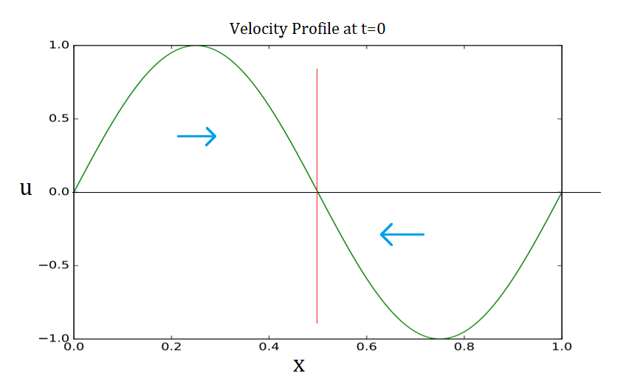
Initial Condition:
$u\left(x,0\right)=\sin\left(2πx\right) x ε (0,1)$ At the boundaries, the velocity is taken to be zero for all times or fluid is enclosed between two walls.

Slide 6
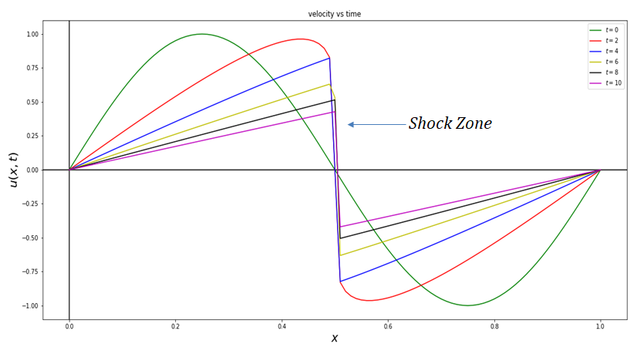
Results:
For 1-D Burgers’ Equation
Inviscid Flow: Plot

Slide 7
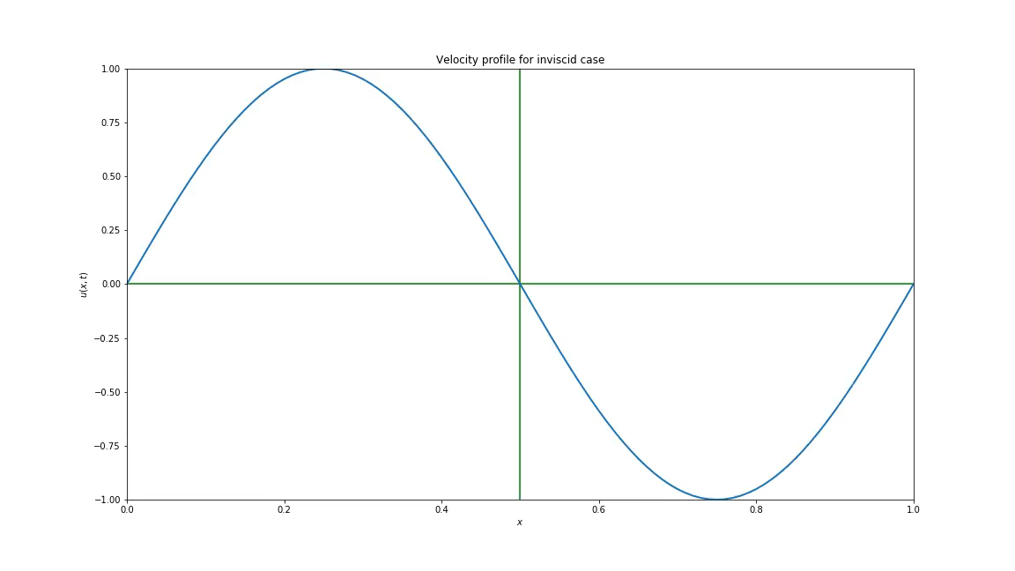
Results:
For 1-D Burgers’ Equation
Inviscid Flow: Animation

Slide 8
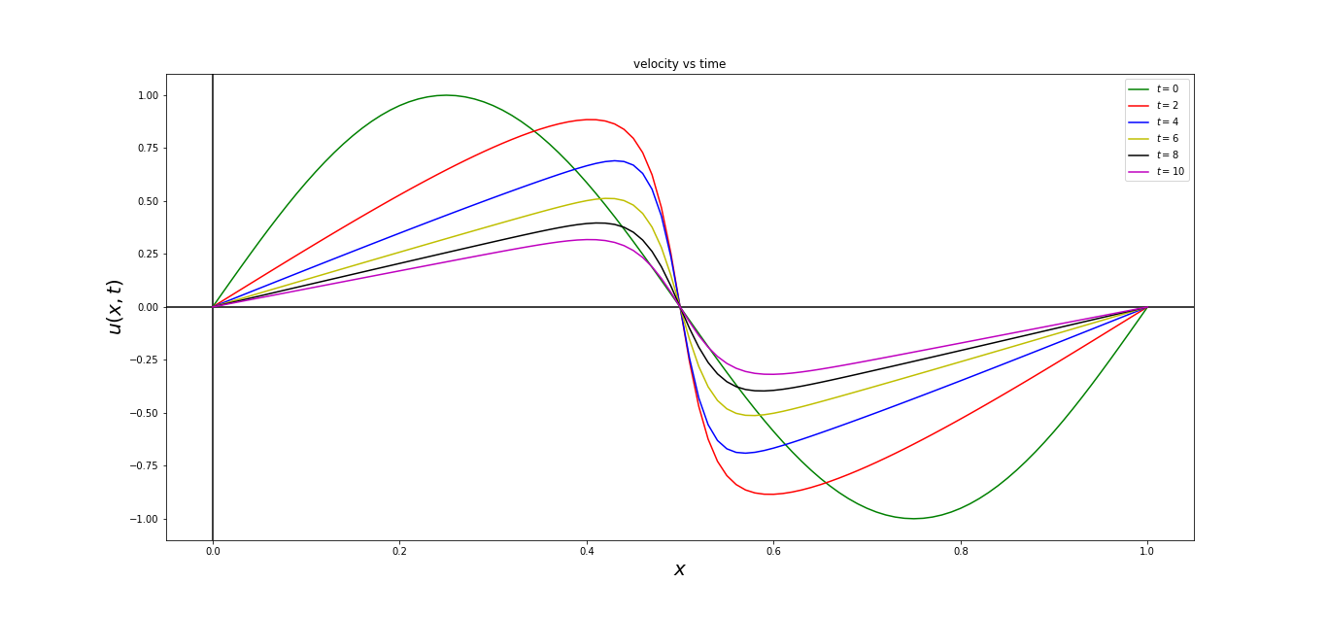
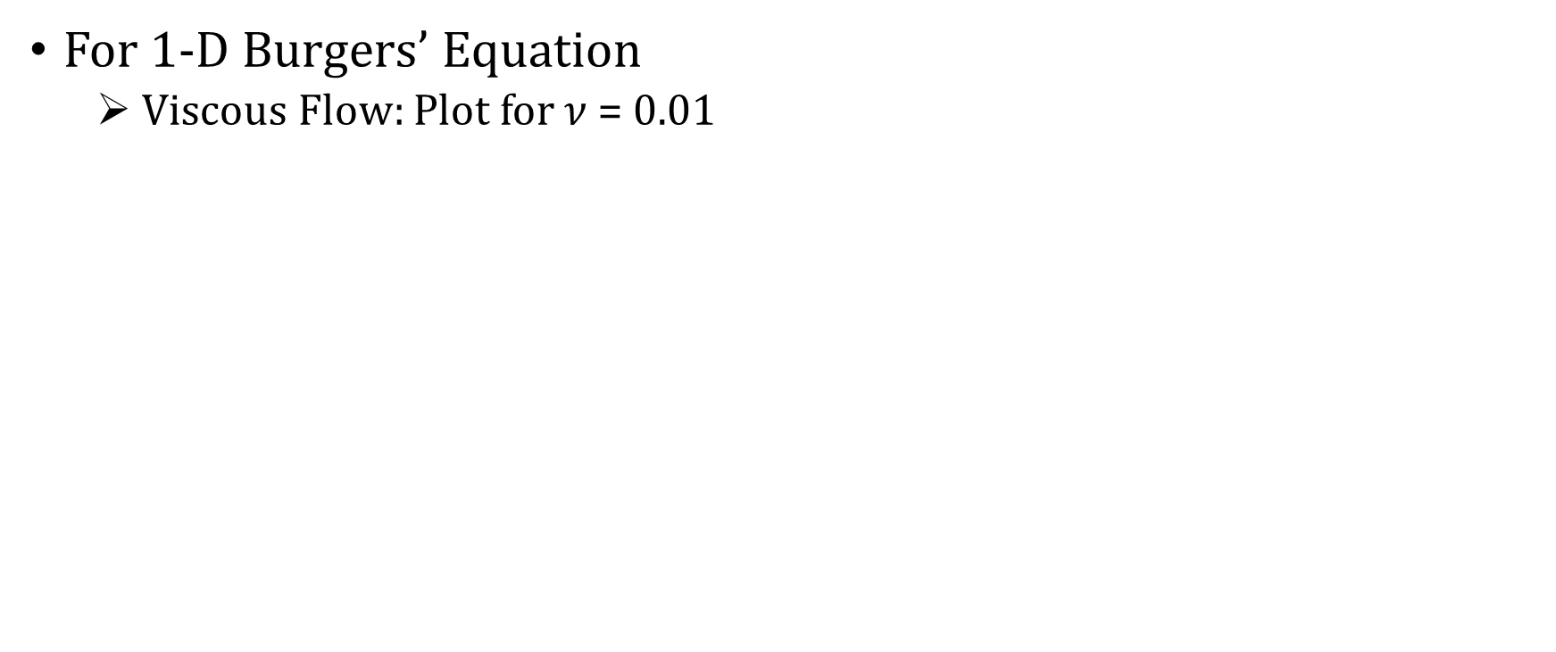
Results:
For 1-D Burgers’ Equation
Viscous Flow: Plot for $ν$ = 0.01

Slide 9
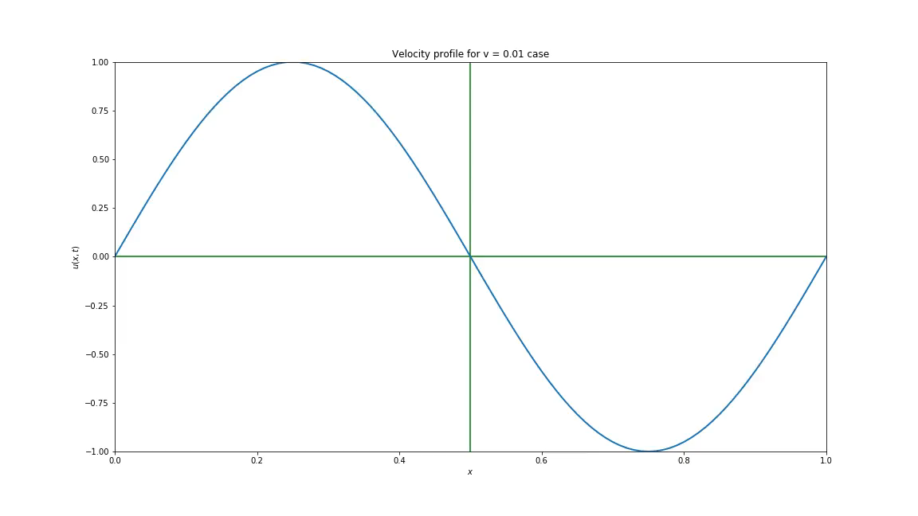
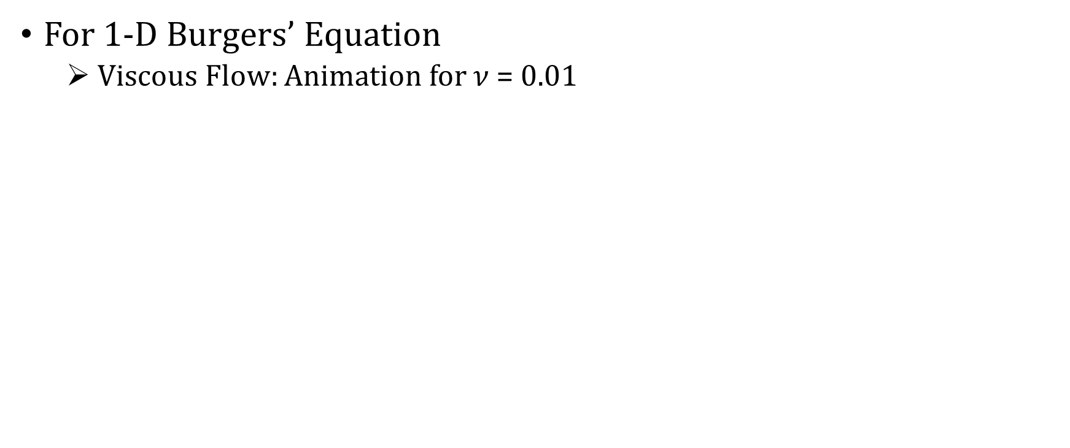
Results:
For 1-D Burgers’ Equation
Viscous Flow: Animation for $ν$ = 0.01

Slide 10
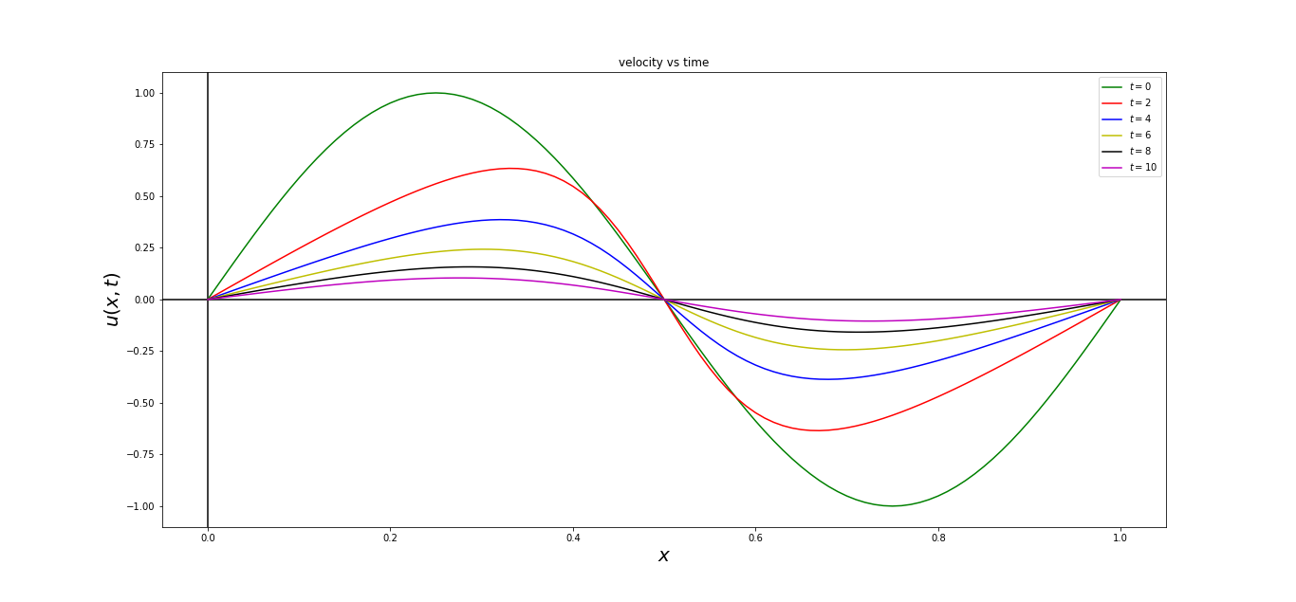
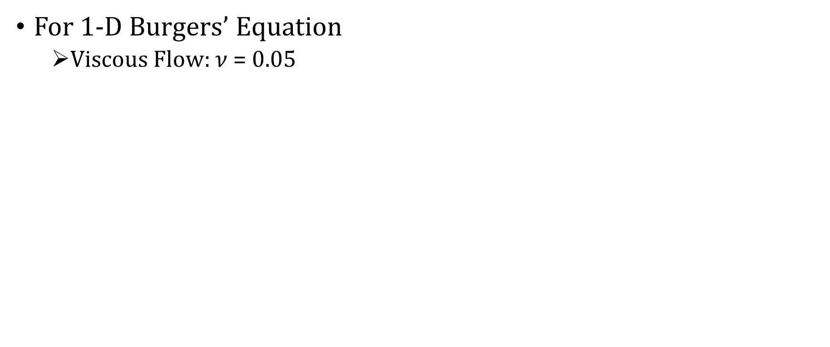
Results:
For 1-D Burgers’ Equation
Viscous Flow: $ν$ = 0.05

Slide 11
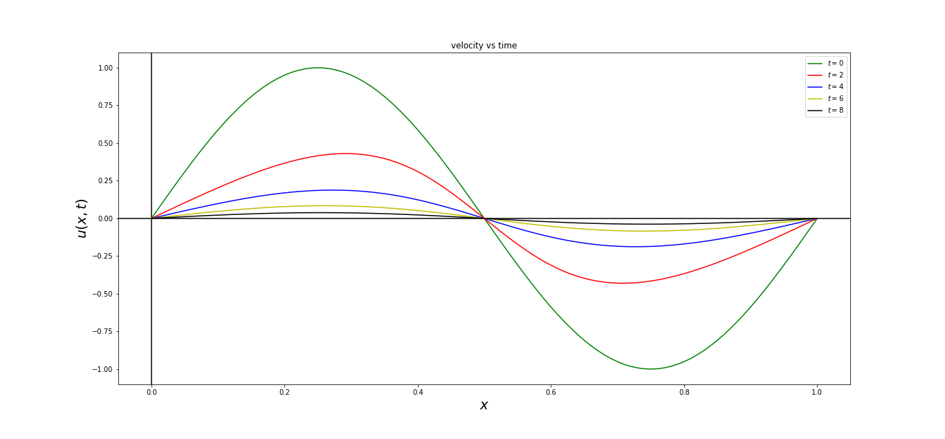
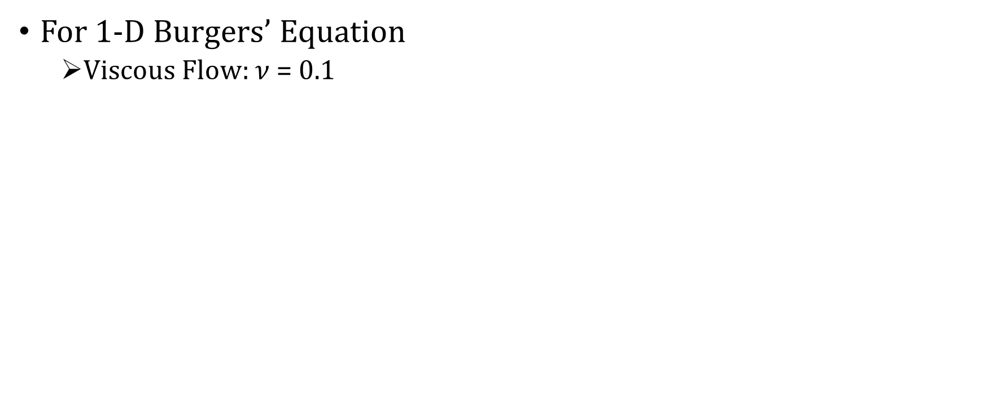
Results:
For 1-D Burgers’ Equation
Viscous Flow: $ν$ = 0.1

Slide 12
Physical Explanation:
We saw that as viscosity was increased, velocity near the centre smoothened out.
In the inviscid case, particles don’t have ability to transfer the kinetic energy unless they collide with the incoming particles.
But, viscosity allows them to decrease the velocity, before reaching the shock zone.
Note: In the inviscid case, the total kinetic energy should remain same.

Slide 13
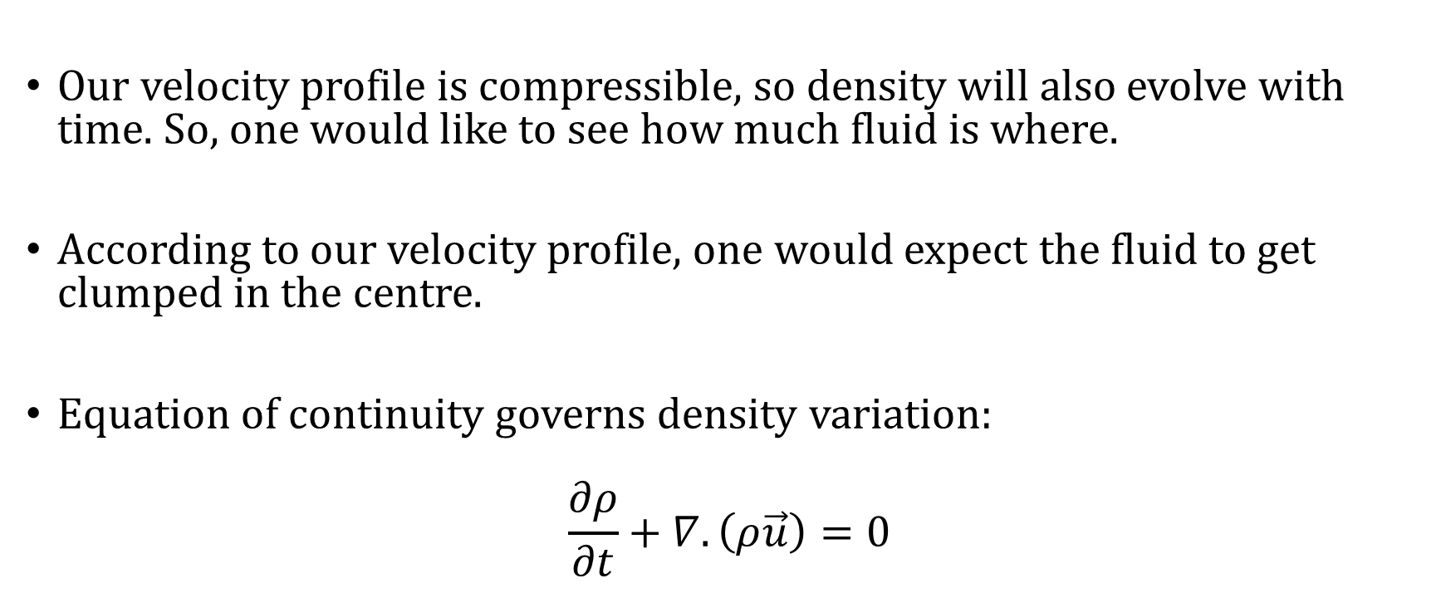
How does the density change?
Our velocity profile is compressible, so density will also evolve with time. So, one would like to see how much fluid is where.
According to our velocity profile, one would expect the fluid to get clumped in the centre.
Equation of continuity governs density variation:
$$\frac{∂ρ}{∂t}+∇.\left(ρ\vec{u}\right)=0$$

Slide 14
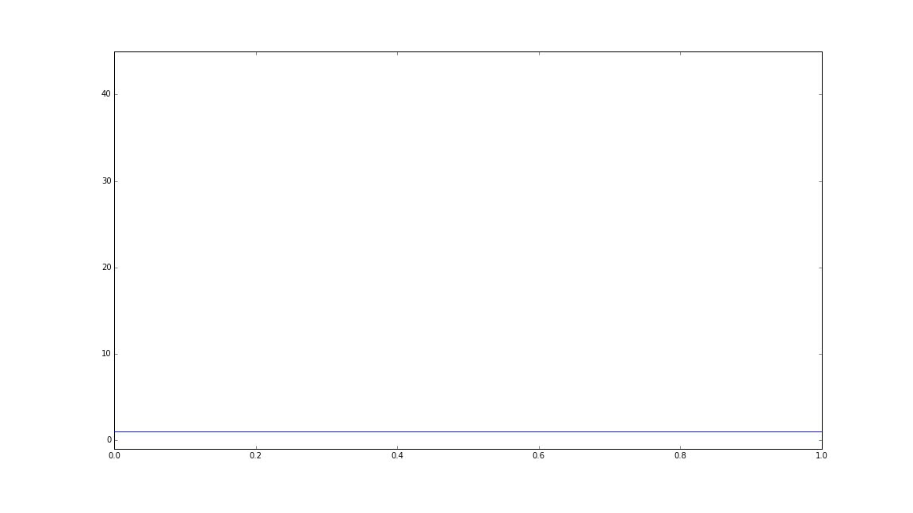
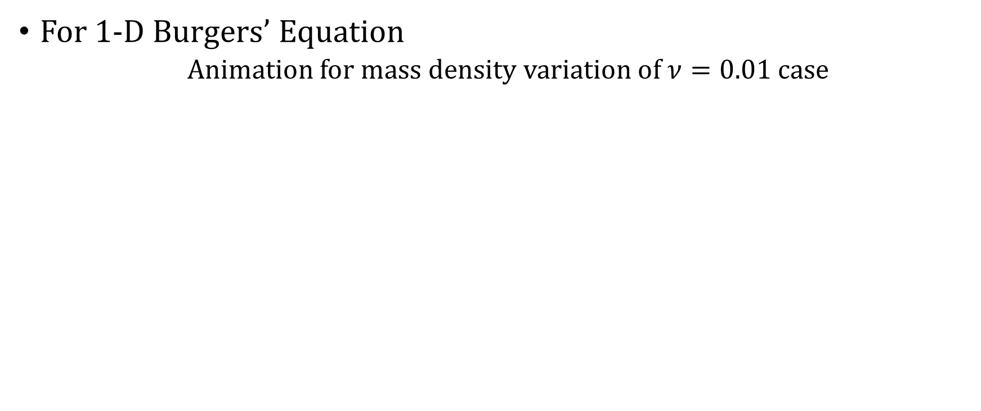
Results:
For 1-D Burgers’ Equation
Animation for mass density variation of $ν=0.01$ case

Slide 15
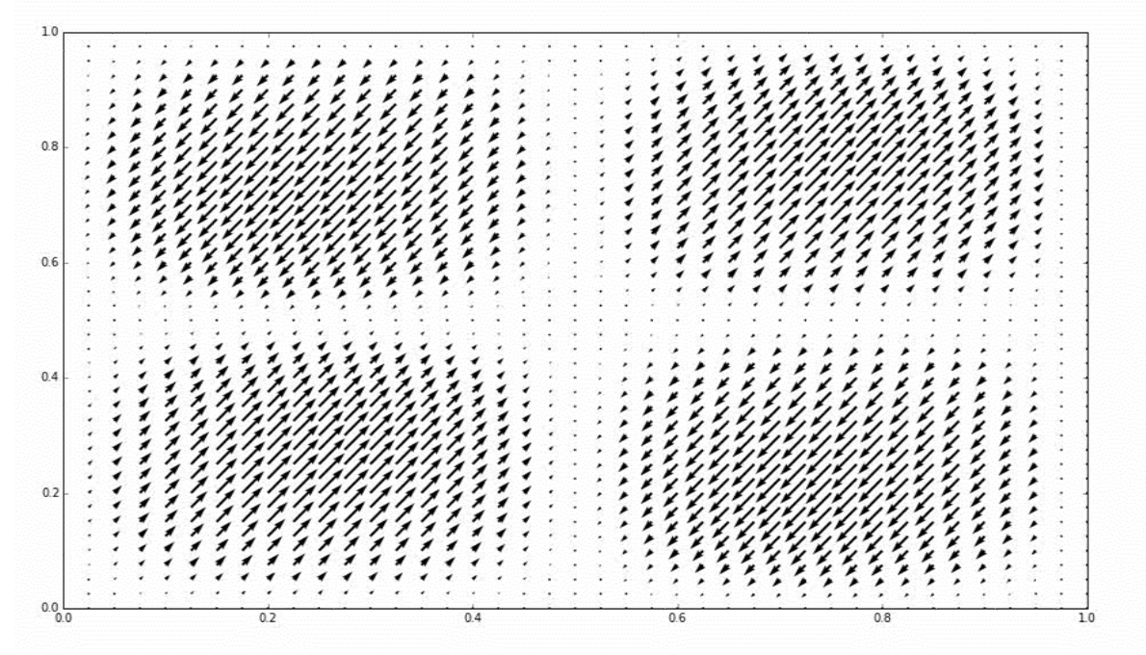
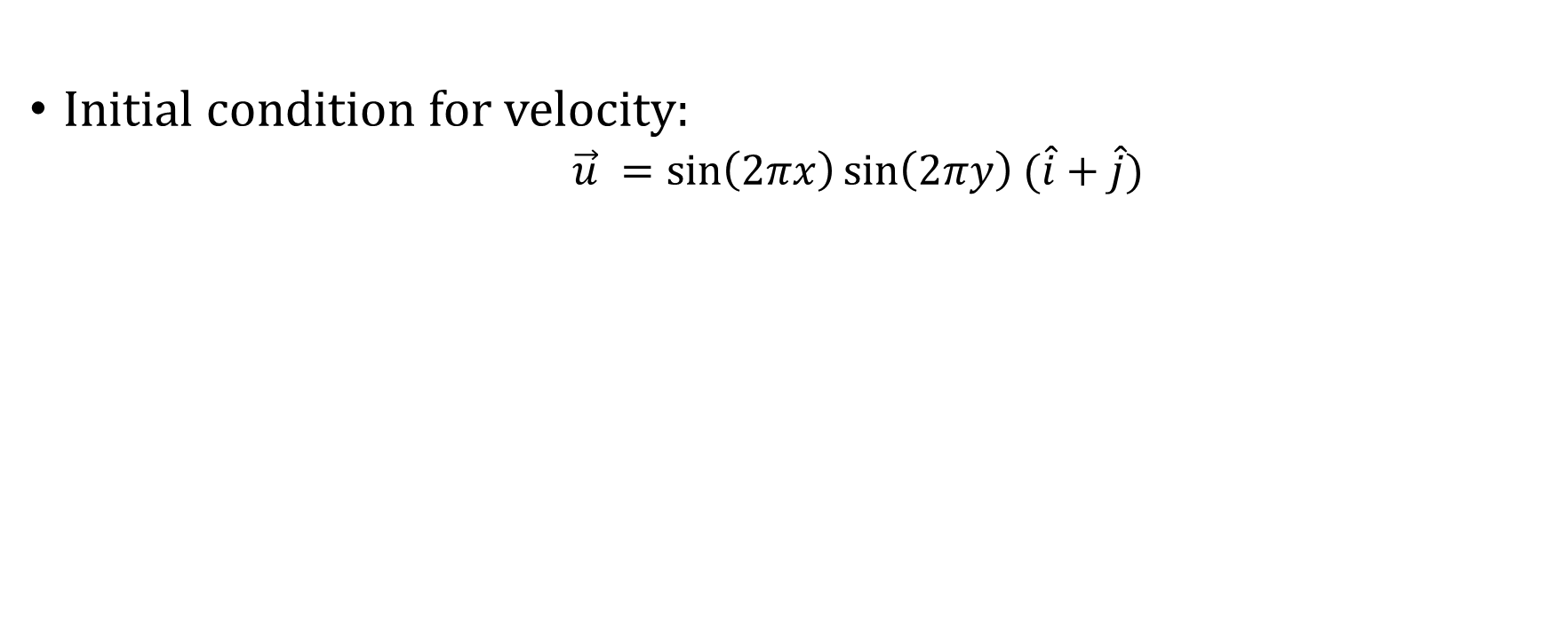
In 2-Dimensions:
Initial condition for velocity:
$\vec{u} =\sin\left(2πx\right)\sin\left(2πy\right) (\hat{i}+\hat{j})$

Slide 16
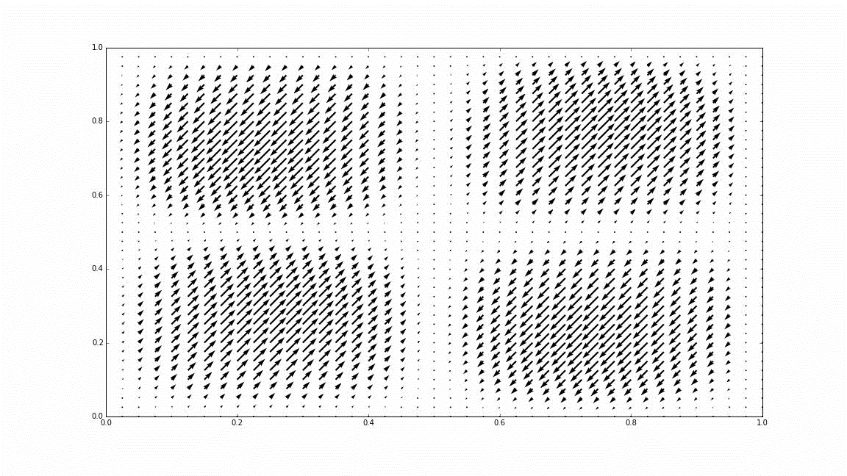
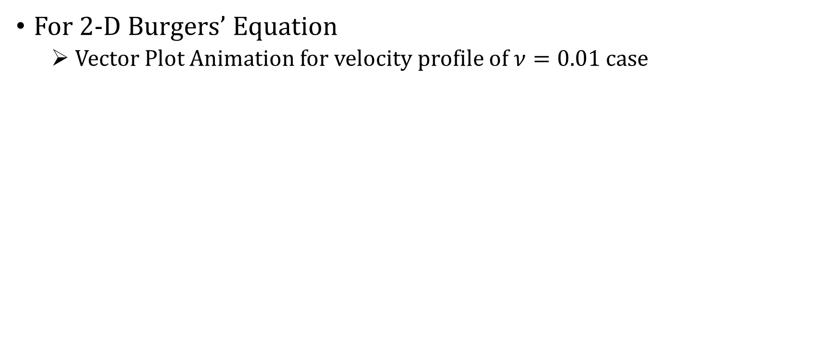
Results:
For 2-D Burgers’ Equation
Vector Plot Animation for velocity profile of $ν=0.01$ case

Slide 17
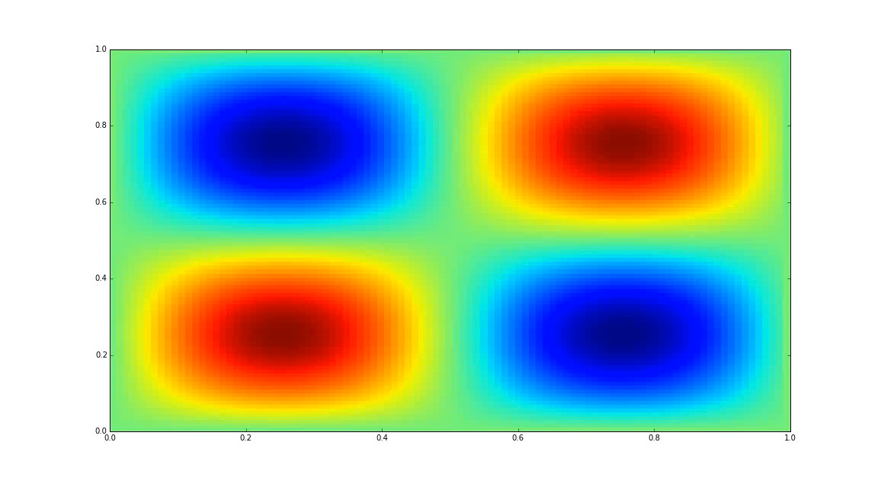
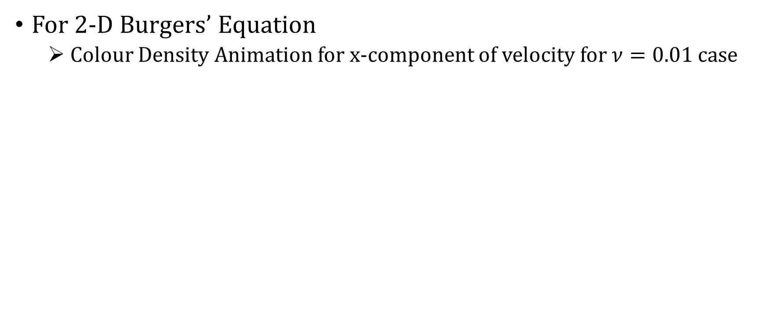
Results:
For 2-D Burgers’ Equation
Colour Density Animation for x-component of velocity for $ν=0.01$ case

Slide 18
Conclusion
Shock formation in non-viscous case.
For viscous case, shock gets mitigated.
Mass density variation – as expected.

